Slide 1
RoboDoc: EEG Mood/Stress Evaluation
Steven R Parker, Daniel Mata, and Mohammed Khamis

Slide 2
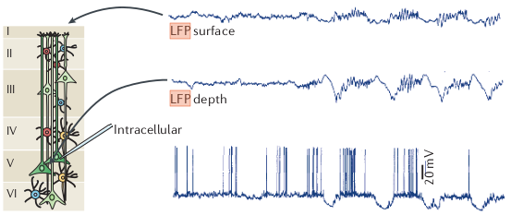
Background
Specific vs General Signals
EEG
Wet vs Semi-Dry EEG
Remote Control, Reenabling
NASA Task Load Index (TLX), a multi-dimensional survey based measure of workload.
The Self-Assessment Manikin (SAM) a non-verbal technique that measures the pleasure, arousal, and dominance associated with a person’s affective reactions.
Notes:
local field potential (LFP; also known as micro‐depth or intracranial EEG 1 )
Any excitable membrane — whether it is a spine, dendrite, soma, axon or axon terminal — and any type of transmembrane current contributes to the extracellular field. Even the slowest fluctuations in glia.
silicon-based polytrodes
NASA Task Load Index (TLX) - a multi-dimensional survey based measure of workload.
The Self-Assessment Manikin (SAM) is a non-verbal pictorial assessment technique that directly measures the pleasure, arousal, and dominance associated with a person’s affective reaction to a wide variety of stimuli.
Image:
Simultaneously recorded LFP traces from the superficial (‘surface’) and deep (‘depth’) layers of the motor cortex in an anaesthetized cat and an intracellular trace from a layer 5 pyramidal neuron. Note the alternation of hyperpolarization and depolarization (slow oscillation) of the layer 5 neuron and the corresponding changes in the LFP. The positive waves in the deep layer (close to the recorded neuron) are also known as delta waves. iEEG, intracranial EEG.
electrocorticogram (EcoG) or intracranial electroencephalography (iEEG),
Inform the audience about the history or driving force behind the
need. The status of current products, services, processes, or
industry offerings.

Slide 3
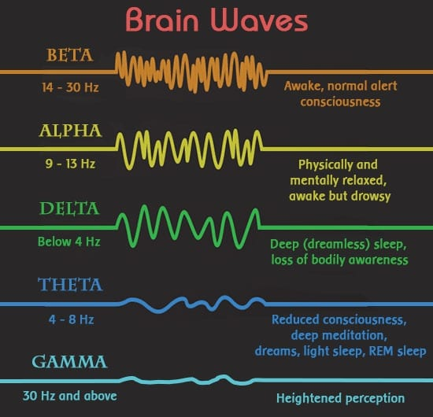

Slide 4
Project Description and Objectives
Emotiv 5-channel Insight.
Survey GUI
Objectives:
Establish ability to read useful data.
Filter unwanted noise.
Matlab - Neural Network AI
Design simple and effective psych intake in the GUI
Notes:
Describe the project. Explain the novel features. List the objectives that the team plans to achieve.

Slide 5
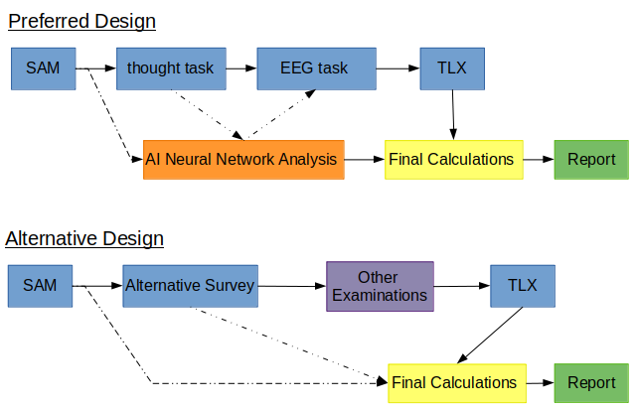
Notes:
Design Overview
Describe the technical design. Include a block diagram. Mention
the preferred and alternative designs.

Slide 6
Design Specifications
Insight: - 5 channels: AF3, AF4, T7, T8, Pz - Resolution: 14 bits with 1 LSB = 0.51μV - Sampling rate: 128 samples per second per channel - Dynamic range (input referred): 8400 μV(pp)
Software: - App Designer Tool for GUI - EEGLAB - Alpha, Beta, and Gamma - Git Collaboration on GitHub
Notes:
8400 μV(pp) = 8400mV from peak to peak
Specifications are quantitative, measurable criteria that the product or service is designed to satisfy. Specification Template:
1. General Information about the product or service or system
• Purpose
• Scope
• Product architecture and overall block diagram
2. Project Standards and Applicable Governmental Regulations. Ex: IEEE, ISO, SAE, UL, etc.
3. Project Description Discuss any of the following topics that apply to the system: • Back-up and recovery requirements • Data migration approach • Capacity analysis • IT functional analysis • Data requirements • Functional and performance requirement description • Hardware and software description • Input and output requirements • Mechanical enclosure(s) • Performance requirements • Support considerations • Systems and communication requirements
4. Attributes • Describe product, service, or process attributes that apply. Be specific and quantitative. Consider verifiability, availability, portability, reliability, reusability, robustness, testability, efficiency, radio frequency interference and noise production, and usability.
5. Design Description: A description of the critical parameters that identifies what the product should be and should do. • Algorithm development • Architectural block diagrams • Capacity • Communications environment—speed, network, throughput, type • Component selection • Connectors and cabling • Data fl ow diagrams • Database schema—tables, fields, and relationships • Functional and performance requirement description • Housing and material • Human–machine interfaces • Inputs—electrical, analog, digital, mechanical, power, torque, data, sensors etc. • Outputs—electrical, analog, digital, mechanical, power, torque, data, display etc. • Power requirements • Thermal requirements • Printed circuit board • Scalability • Size, shape, weight, color • Speed • Shelf life • Service life • Use cycle
6. Interfaces • User Interfaces • Hardware Interfaces • Software Interfaces • Safety and/or regulatory compliance
7. Reliability—a measure of how well a product performs under a certain set of conditions for a specified amount of time. May be required to determine the length of a proposed warranty or prove that the product meets specific safety or regulatory requirements. Reliability is quantified as MTBF (Mean Time Between Failures) for repairable product and MTTF (Mean Time To Failure) for non-repairable product.
8. Safety and Hazardous material Issues
9. Environment: Example environmental conditions include the following: • Operating and storage temperature levels • Operating and storage humidity levels • Operating noise level • Vibration levels • Shock loading • Exposure to dirt and other contaminants like salt spray, oil, or gas
10. Testing: Procedures for testing the functionality and performance

Slide 7
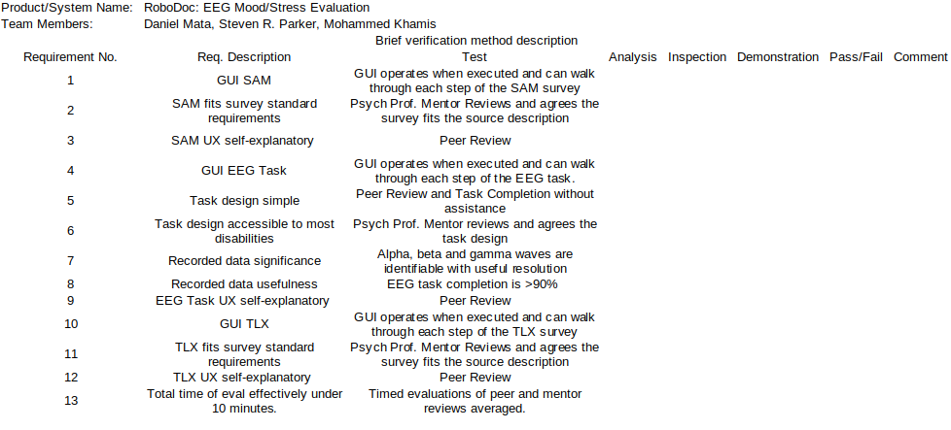
Test Methodology
Notes:
What constitutes project success and how will the team assess
it?
Discuss the development and use of a design verification matrix

Slide 8
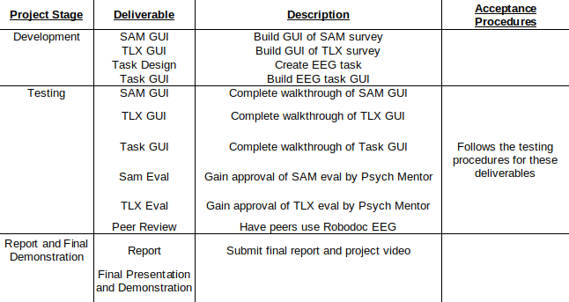
Project Deliverables

Slide 9
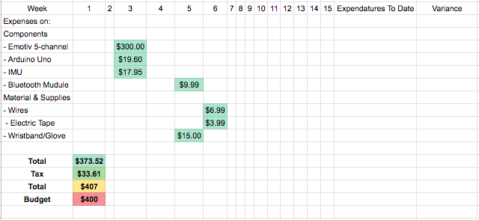
Project Budget

Slide 10
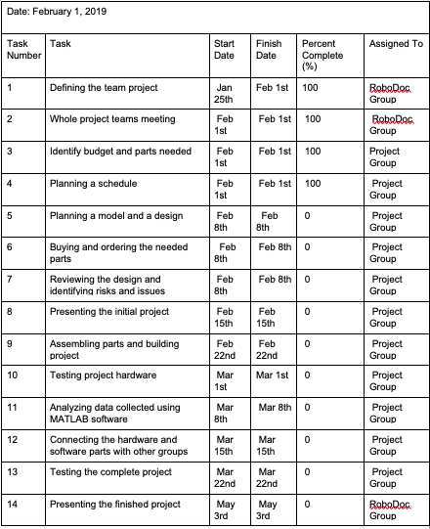
Project Schedule

